Slide 1


Iris Flower Data Analysis
Interactive analysis based on random forest and K-means
Yaxuan zhang

Slide 2
Project Overview
0
1
Objective
To build an interactive interface for conducting the entire analysis of the iris dataset
To combine supervised learning (classification) and unsupervised learning (clustering) to extract data features
To present the data distribution, model performance, and clustering results through visualization tools
Technical stack
Languages/Libraries: Python, NumPy, Pandas, Matplotlib, Seaborn
Machine learning: Scikit-learn (Random Forest, PCA, K-means)
Interface: Tkinter (GUI development)

Slide 3
System architecture and functional modules
Interactive parameter setting
Multidimensional analysis
Supports dynamic adjustment of test set ratio, random seed, model hyperparameters, etc.
Exploratory Data Analysis (EDA): Feature Relationship Matrix, Correlation Heatmap
Supervised Learning: Random Forest Classification (GridSearchCV for Parameter Tuning)
Unsupervised Learning: K-means Clustering (Optimal Cluster Number determined by Elbow Rule)
Data loading and preprocessing
Result visualization
Automatically obtain the UCI Iris dataset
Label encoding (categories → numbers), feature standardization (Z-score)
4 main tabs (Data Overview, EDA, Model Results, Cluster Analysis)
Including confusion matrix, feature importance, ROC curve, cluster distribution, etc. 10 + charts

Slide 4
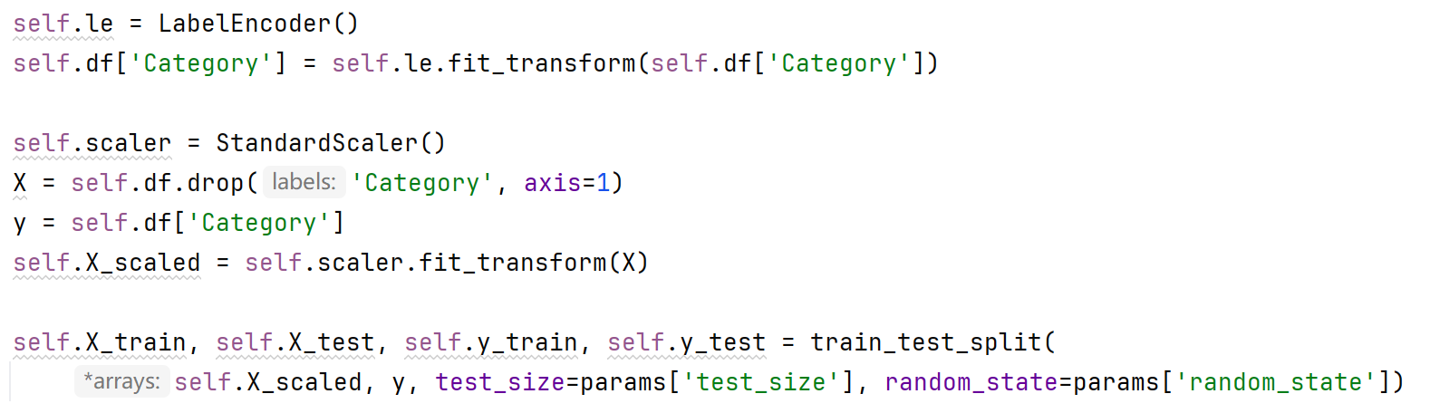
Data Overview and Preprocessing
Preprocessing procedure
Dataset characteristics
Feature name | Type | Description
Length of the calyx | Numeric type | Unit: cm
The width of the calyx | Numeric type | Unit: cm
Petal length | Numeric type | Unit: cm
Petal width | Numeric type | Unit: cm
Category | Classification type | 3 types (Mountain Iris, Variegated Iris, Virginia Iris)

Slide 5
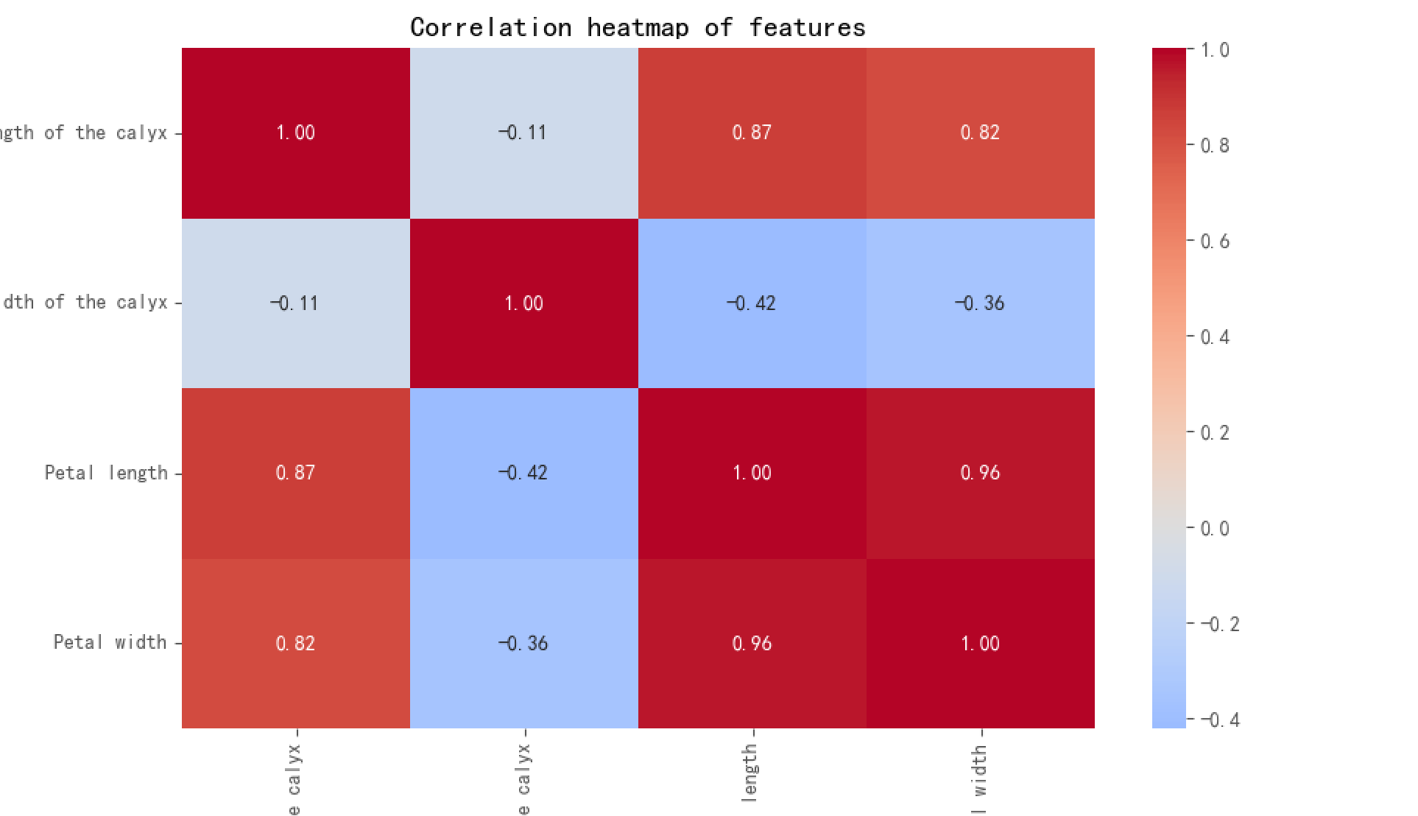
Exploratory Data Analysis (EDA)
Correlation heatmap
Petal length is positively correlated with petal width and height (r = 0.96)
Calyx length is moderately positively correlated with petal length (r = 0.87)

Slide 6
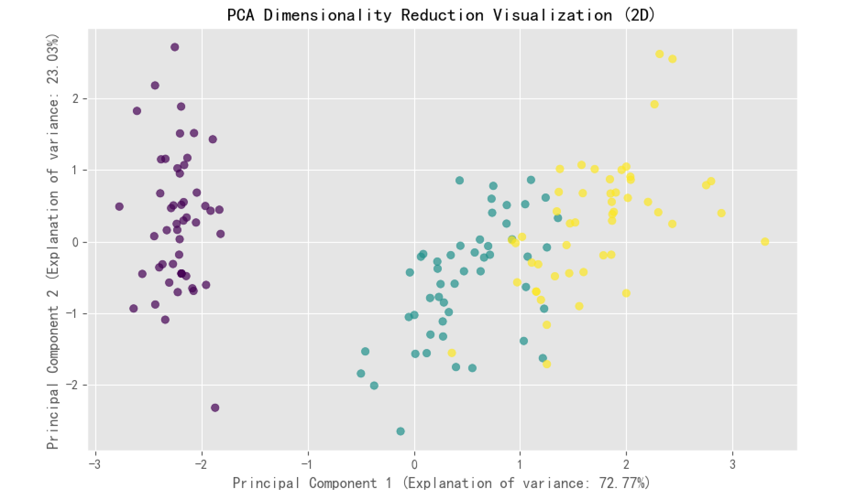
Exploratory Data Analysis (EDA)
PCA dimensionality reduction visualization
The first 2 principal components explain 95.8% of the variance
Different categories can be approximately linearly distinguished in the two-dimensional space

Slide 7
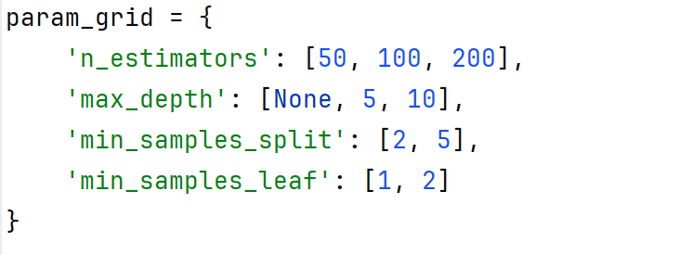
Supervised learning model: Random Forest Classification
Parameter grid
Optimal parameters
n_estimators=100, max_depth=None, min_samples_split=2, min_samples_leaf=1
Evaluation indicators
Visualization results
Indicators | Value | Explanation
Accuracy rate | 0.98 | Accuracy of classification in the test set
Multi-category AUC | 0.99 | Area under the ROC curve based on the OvR strategy
Visualization results
Confusion matrix: Only 1 misclassification (checkered iris → virginica iris)
Feature importance: Petal length (0.45) > Petal width (0.38) > Petal width (0.12) > Petal width (0.05)

Slide 8
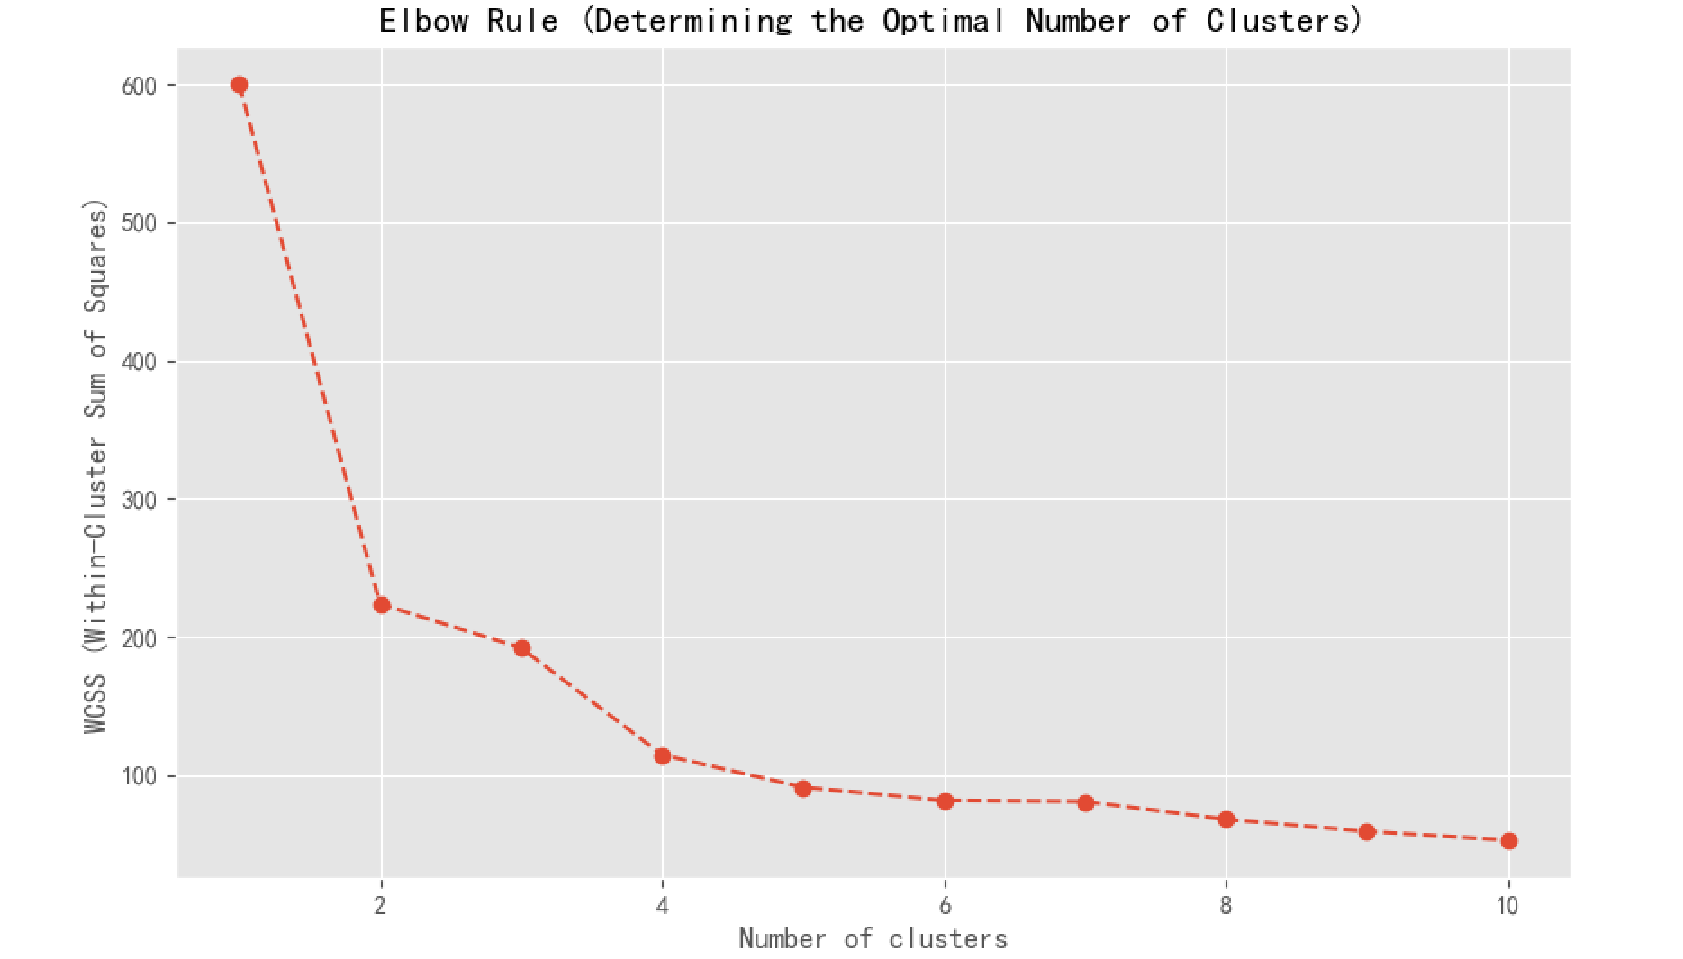
Unsupervised learning: K-means clustering analysis
The elbow rule determines the number of clusters
When k = 3, there is a significant inflection point in the WCSS (within-cluster sum of squares)

Slide 9
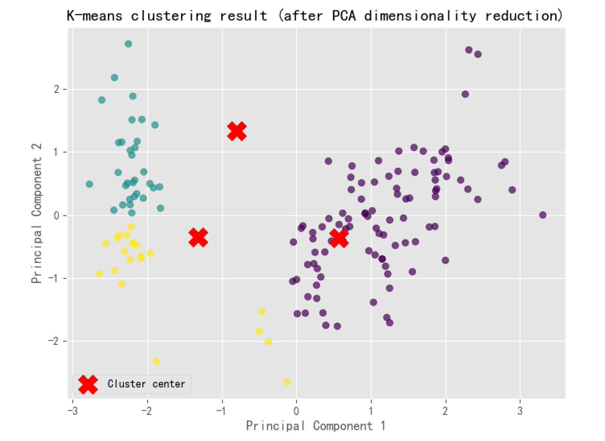
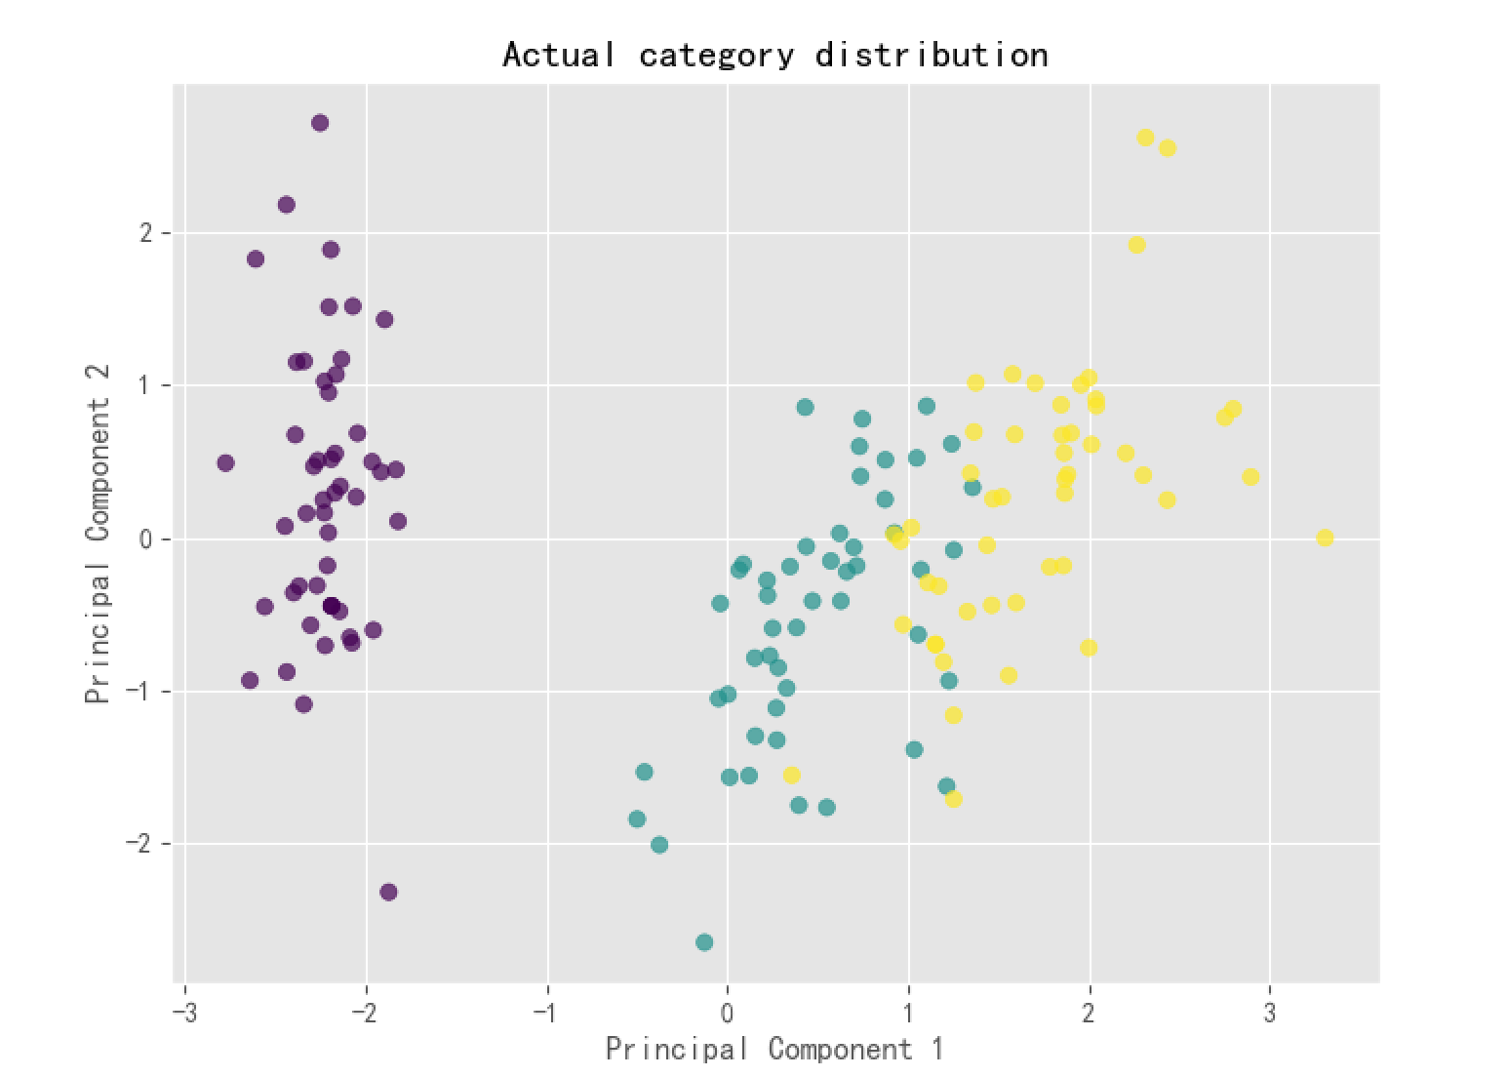
Unsupervised learning: K-means clustering analysis
Visualization of clustering results
Left figure: K-means clustering results (red Xs represent cluster centers)
Right figure: Actual category distribution
Clustering coefficient: 0.82 (close to 1, indicating a good clustering effect)

Slide 10
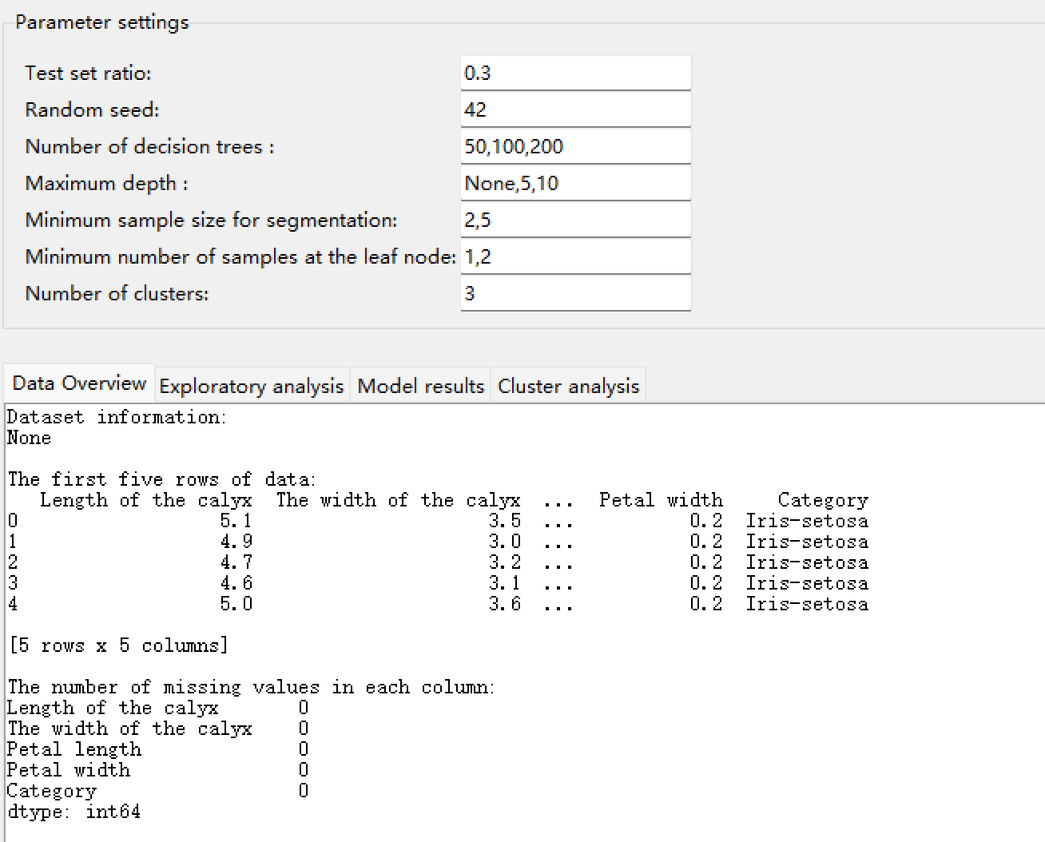
System interface demonstration
Parameter setting interface
Users can dynamically adjust the test set ratio, random seed, model hyperparameters, etc.
Multi-tab result display
Data overview: Show the first 5 rows of data, missing value statistics
Model results: Real-time update of confusion matrix, classification report
Cluster analysis: Compare cluster results with actual categories

Slide 11
Summary and Outlook
Project Value
Provides a one-stop iris flower data analysis tool, suitable for both research and teaching scenarios
Combines visualization and interactive operations to lower the entry barrier for machine learning
Future optimization directions
Integrate more algorithms (such as SVM, neural networks)
Add data upload function (support for local CSV files)
Optimize interface interaction experience (such as adding a chart download button)

Slide 12
Thanks！
Yaxuan zhang

